Slide 1
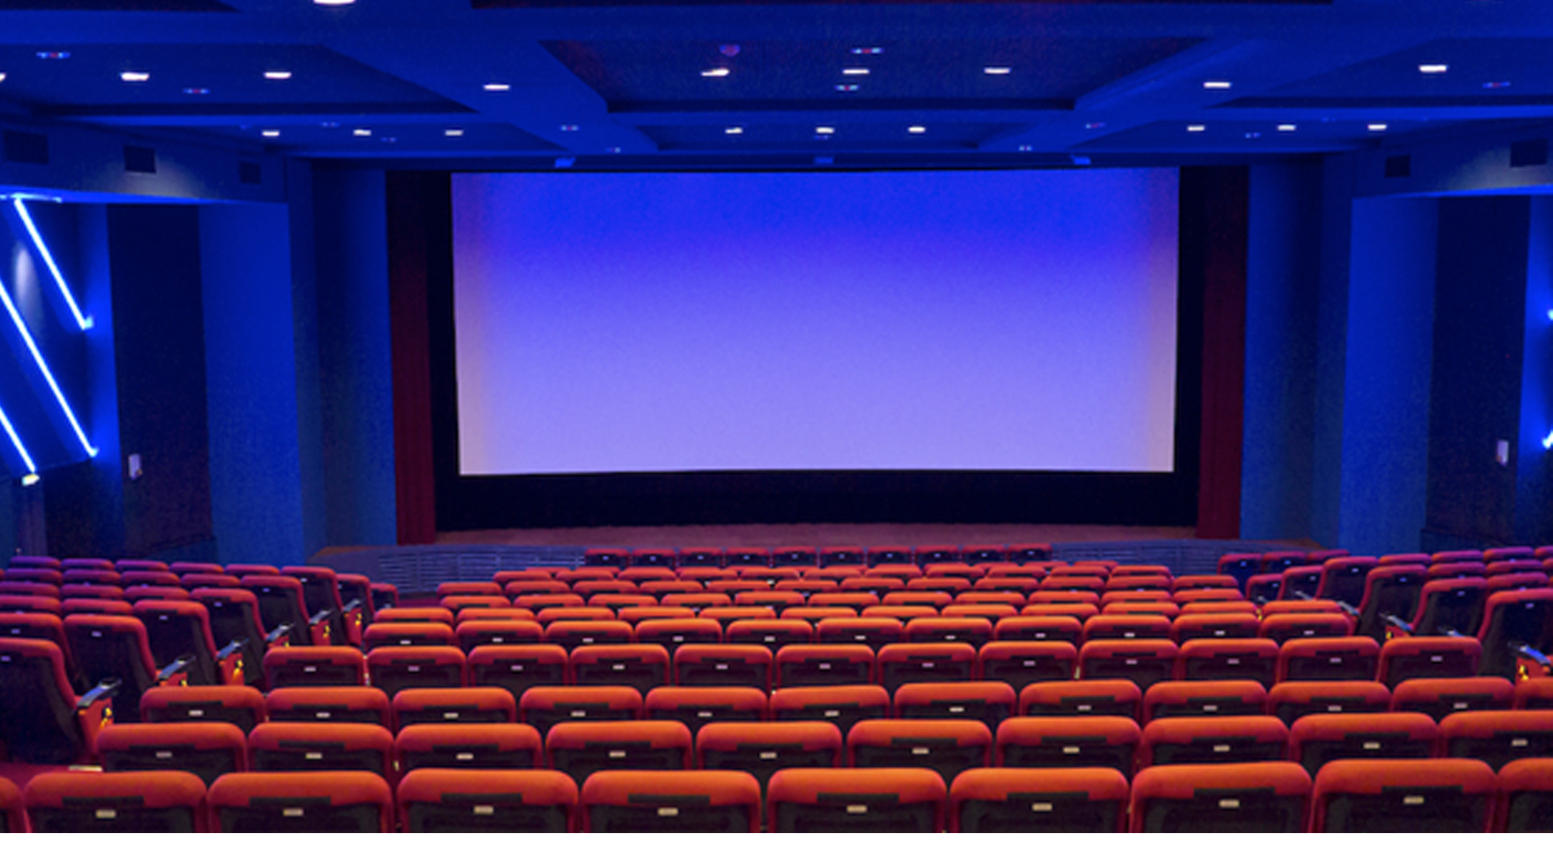
The virtual reality INTEGRATION FOR CINEMA
2
+
2
+
By George Mavroeidis

Slide 2
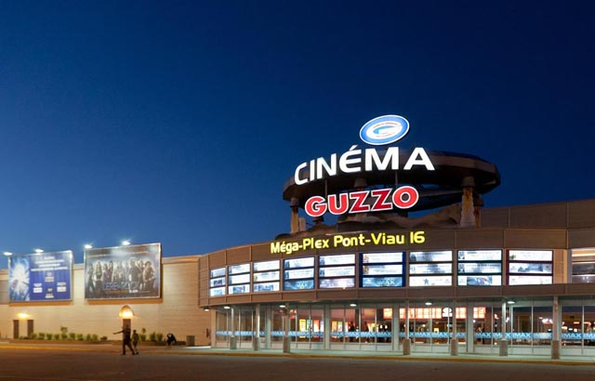

Why cinema is dead?
2
+
2
+
Loss of immersion
External audience distractions
Costly tickets
Home streaming and comfort

Slide 3

Why virtual reality?
2
+
2
+
Allows for full 360 view
Fully immerses audience
Minimizes external audience distractions
Detaches viewer from reality
Big screen is obsolete
Reduces room size
Reduces ticket costs

Slide 4
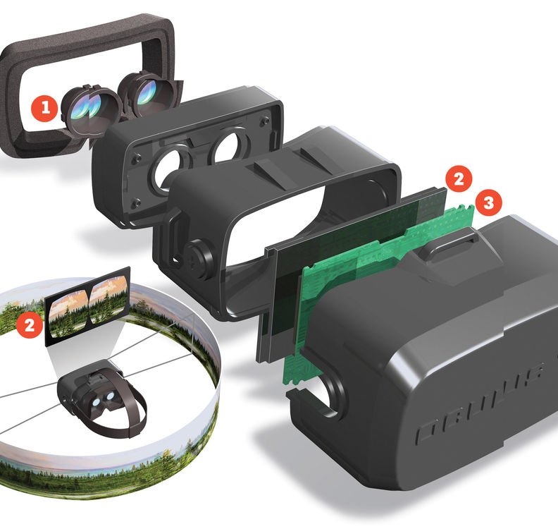
HOW WILL IT WORK IN CINEMA?
2
+
Films will be recorded with cameras with 360 angle capabilities
CG Animated films will be rendered in real time with 360 angle capabilities
VR Headgear headtracking
Each chair will have its own gear
Each chair will be connected to a central control booth within the room
Construct smaller cinema rooms
Optimize sound proofing with Acoustic Styrofoam panels

Slide 5
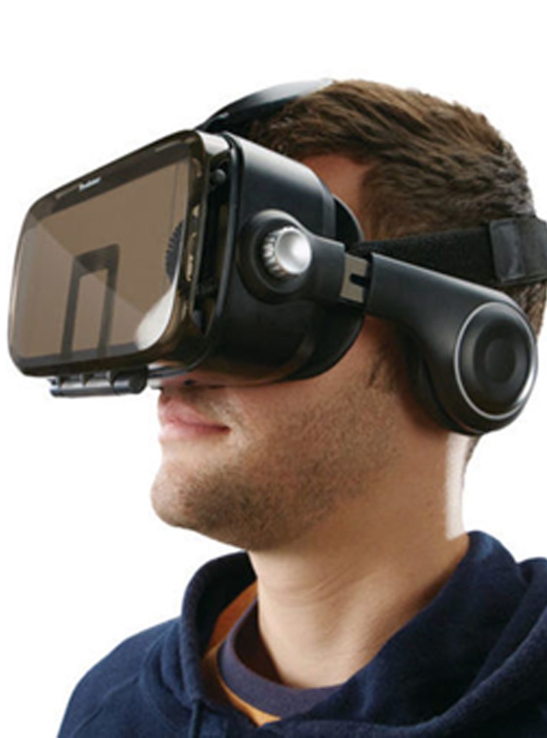
schedule
The project will ideally have a span of 4 to 5 months
The scheduling is separated into eight subsections
The room overhaul and R&D make up the majority
The staff training must commence after the constructions and installations have been completed

Slide 6
HOW MUCH IT COSTS?
The budget is separated into three core parts
Management: project management, investment management and IT management
Salary: software, hardware and building engineers, transportation, designers
Equipment and Material: VR headgear, room insulation, computers, Styrofoam panels, LED lights, specialized cinema chairs

Slide 7

Title
2
+
WHO WILL HELP ME?
Unity technologies have been the leading software developers for VR/AR integrations to industries such as games, architecture, automobile and more

Slide 8
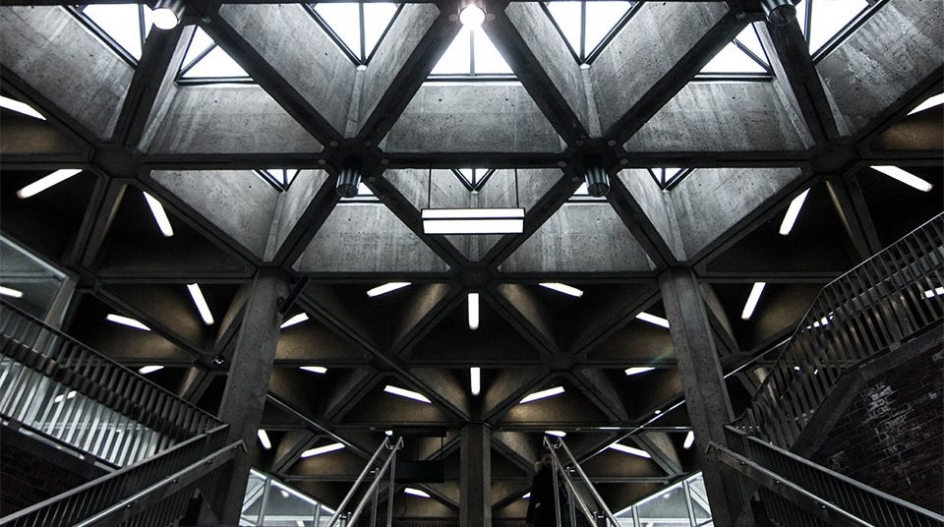
THANK YOU
2
+
2
+
Reference material found in my proposal

